Slide 1

Generative AI Academy

Slide 2
Gen AI use-cases
across job functions and industries

Slide 3

The economic potential of generative AI: The next productivity frontier

Slide 4
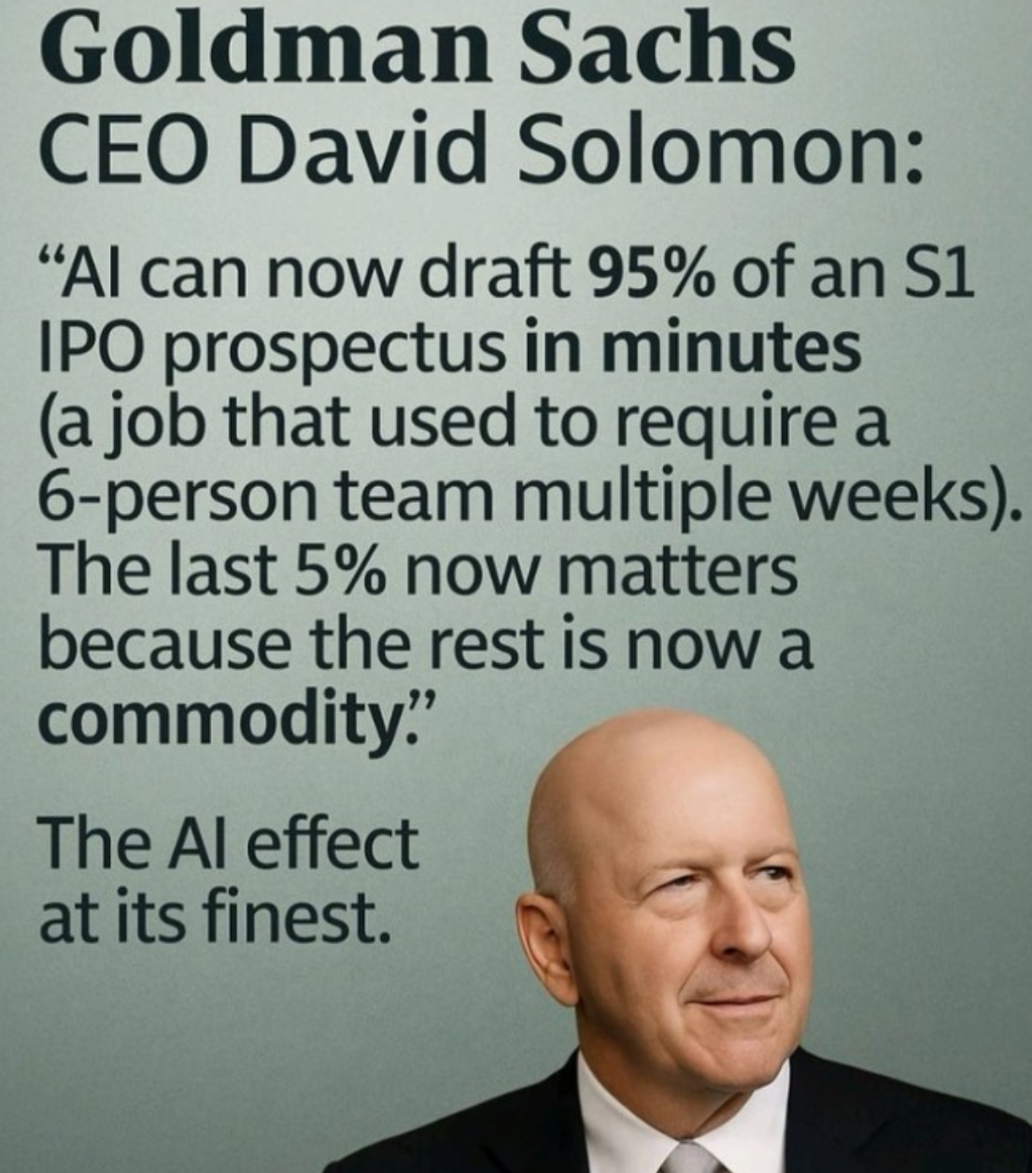

Slide 5

https://www.mckinsey.com/capabilities/mckinsey-digital/our-insights/the-economic-potential-of-generative-ai-the-next-productivity-frontier#introduction

Slide 6
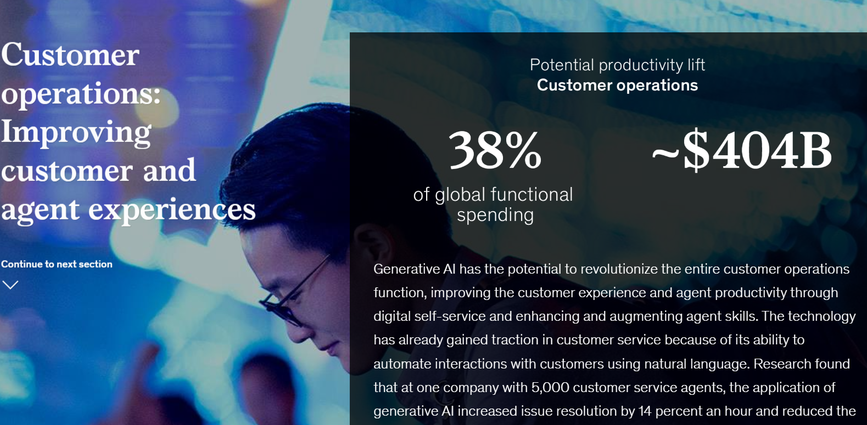
Customer Operations
Source: McKinsey Digital

Slide 7
Customer Operations / Support use-cases
Intelligent support agent
Voice assisted
Trained on company policies, tone, approach
Agent will have access to real time product and purchase information
Source: McKinsey Digital

Slide 8
Customer Operations / Support use-cases
Research found that at one company with 5,000 customer service agents, the application of generative AI :
Increased issue resolution by 14 percent an hour
Reduced the time spent handling an issue by 9 percent.
Reduced agent attrition and requests to speak to a manager by 25 percent.
Productivity and quality of service improved most among less-experienced agents

Slide 9
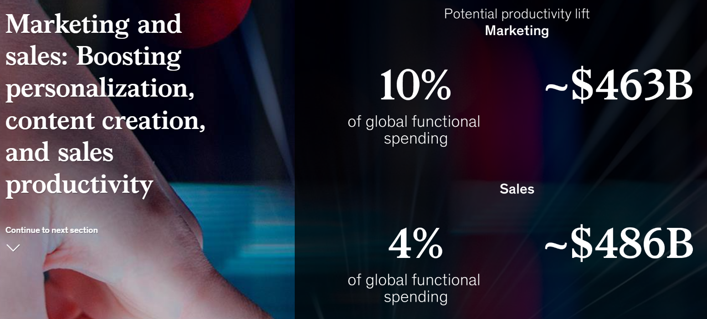
Marketing and Sales
Source: McKinsey Digital

Slide 10
Marketing and Sales use-cases
Marketing communications
Targeted
Personalized
Brand content creation (images, articles, blogs, social media posts)
SEO optimization
Sales lead generation and lead development
Market research (segments, geographies, demographics)
Lead research
Lead nurturing
Competitive analysis and positioning
SWOT Analysis

Slide 11
Marketing and Sales use-cases
Marketing demo:
Hyundai - AI powered Instagram Creativity
https://www.hyundai.news/eu/articles/press-releases/santa-fe-ai-generated-campaign-invites-instagram-users-to-dream-destinations.html
Product research demo
Lead nurturing demo

Slide 12
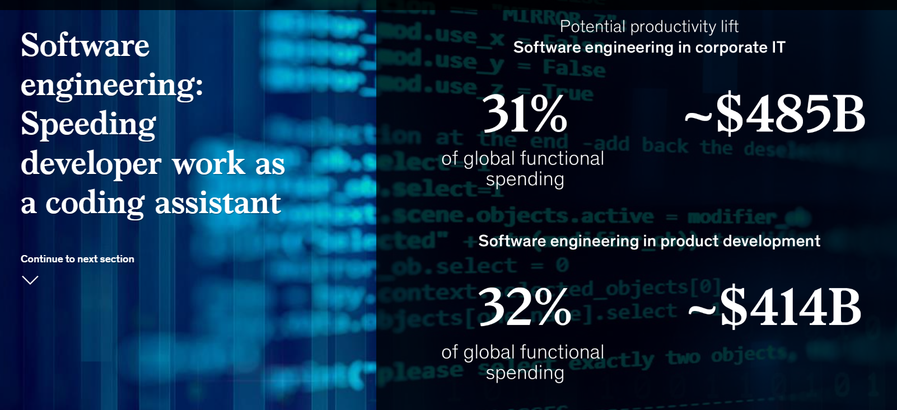
Software Engineering

Slide 13
Software Engineering use-cases
Requirements analysis
Technical architecture and choices generation keeping platform, cost, performance requirements in mind
Frontend / UI Code generation from mockups
Development (database, schema, middle tier code) with Gen AI
Test case generation, test code generation, tests execution, tests results analysis
Test failure analysis and bugfixing
Self healing!!

Slide 14
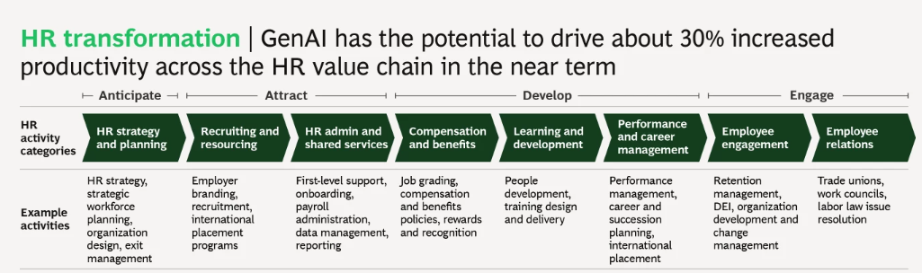
Human Resources (HR), Learning & Development (L&D)

Slide 15
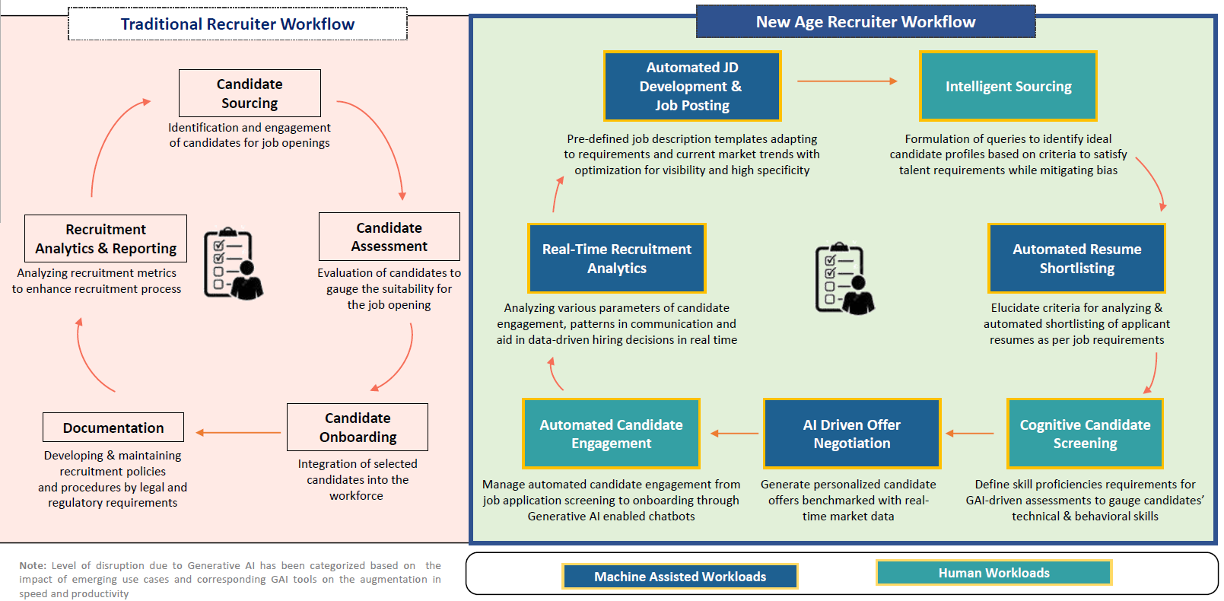
Talent acquisition transformation

Slide 16
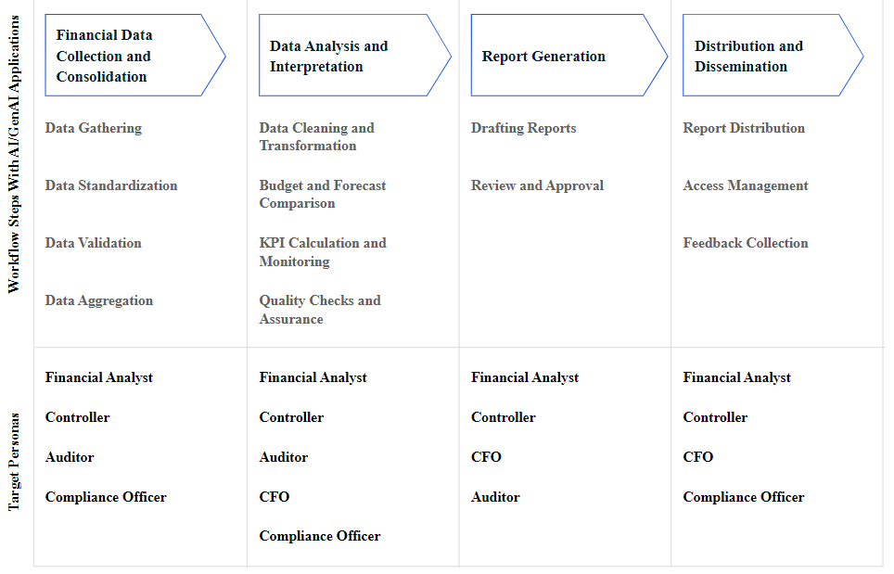
Gen AI in Finance functions (CFO)
https://www.leewayhertz.com/ai-for-financial-reporting/#benefits-of-ai-in-financial-reporting

Slide 17
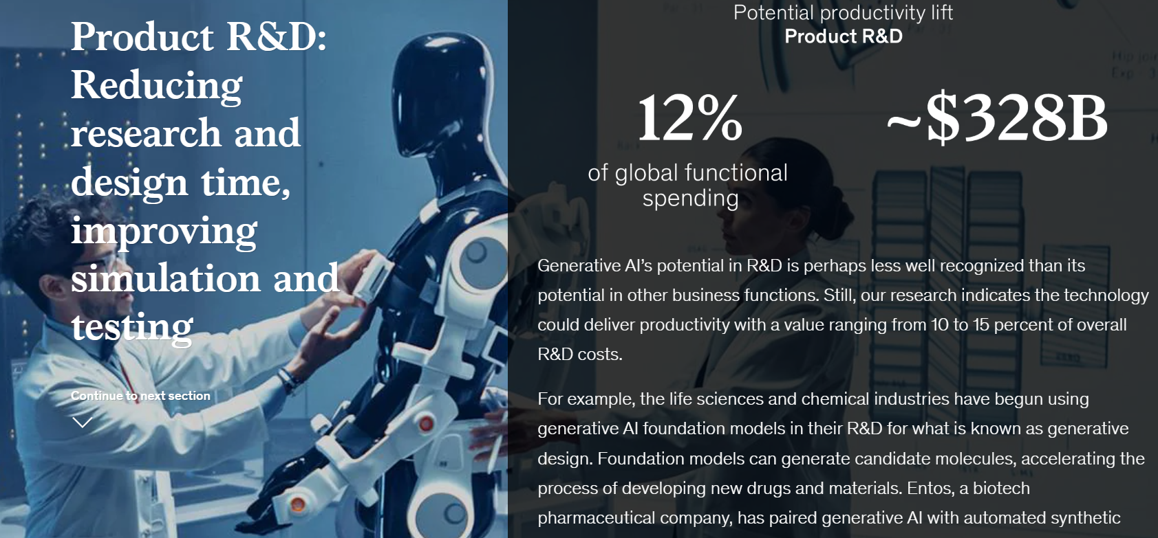
Product Research and Development

Slide 18
Product Research and Development
Boeing is using Generative AI to design airplane parts

Slide 19
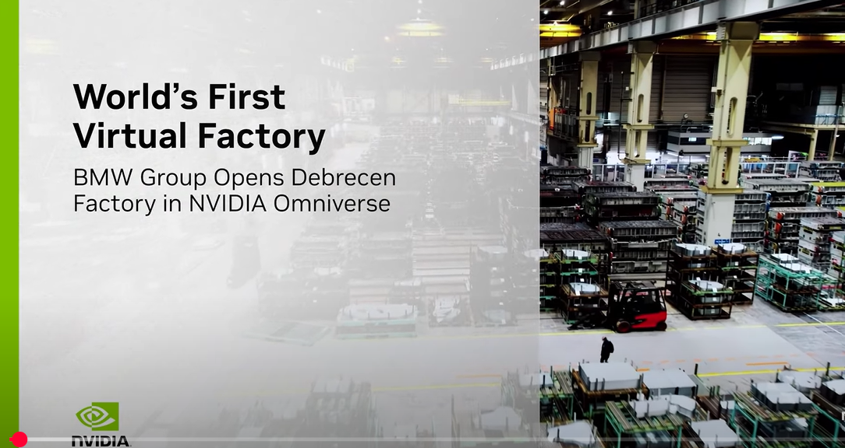
BMW – Digital Twin virtual factory
https://www.youtube.com/watch?v=g78YHYXXils

Slide 20

Toyota – Generative designs for vehicles
https://www.youtube.com/watch?v=xkwwIDgrmbk

Slide 21


Slide 22
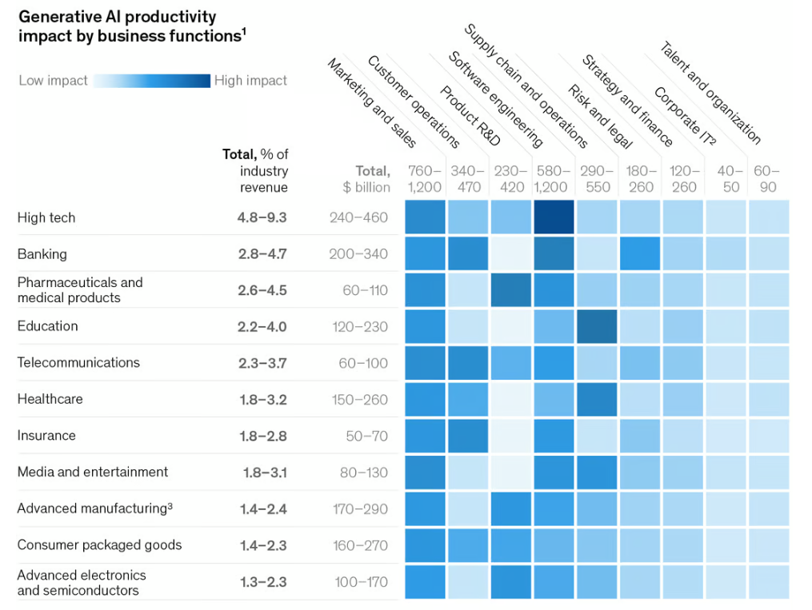
Impact across industries

Slide 23
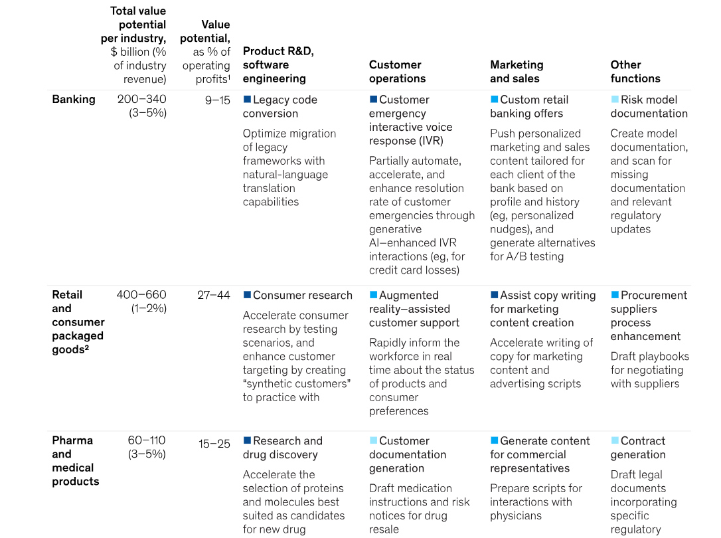

Slide 24

Optimizing field operations with AI-ML
https://www.youtube.com/watch?v=znz5_VbzxPU

Slide 25

Automotive – in vehicle experience
The Mercedes-Benz Intelligent Vehicle Assistant,
"Hey Mercedes," offers a hyper-personalized user experience
Leveraging large-scale Generative AI models and Azure OpenAI Services GPT-4 Turbo with vision, it integrates seamlessly with multimodal components to provide real-time assistance and contextual information.
https://www.youtube.com/watch?v=ocxnhqZuS8w

Slide 26
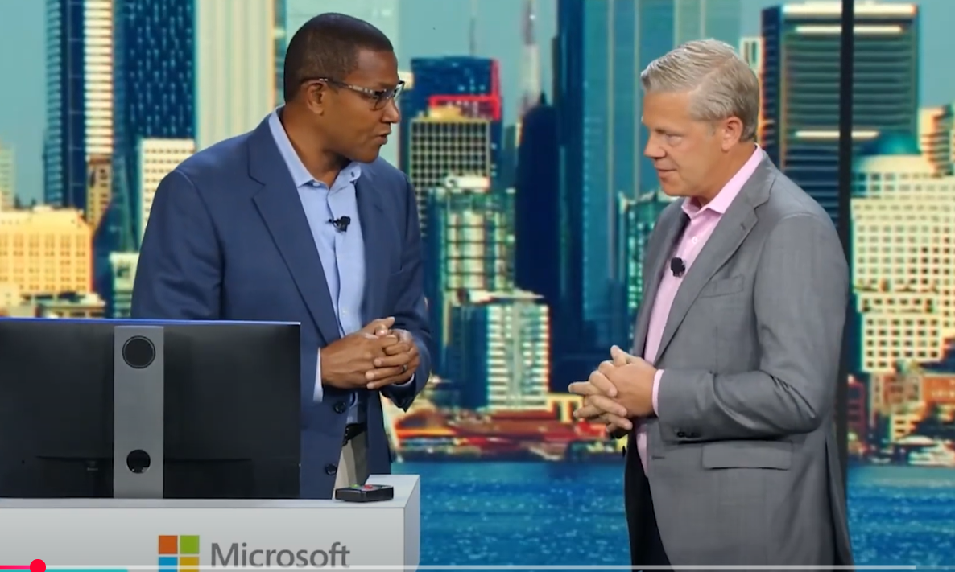
Moody’s Copilot
https://www.youtube.com/watch?v=7O8jtu3bpS8

Slide 27

Chemical plant automation with AI
https://www.youtube.com/watch?v=g4H6Fkag3cY

Slide 28
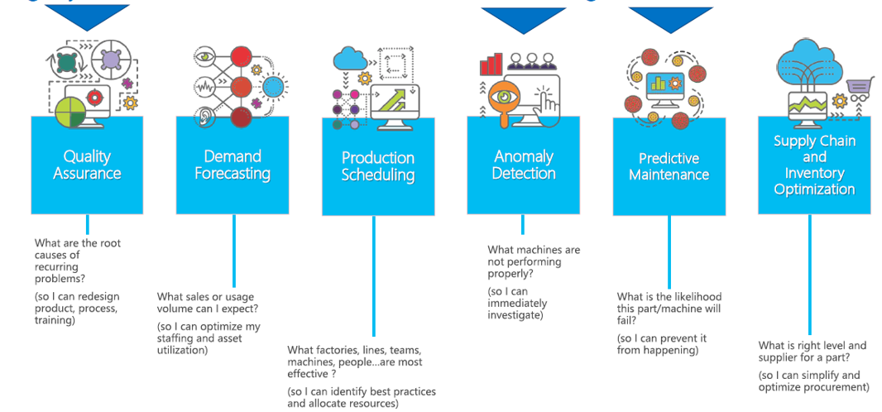
High yield use-cases in manufacturing

Slide 29


Predictive maintenance
Predictive maintenance – vision model approach
Corrosion detection
Leak detection

Slide 30
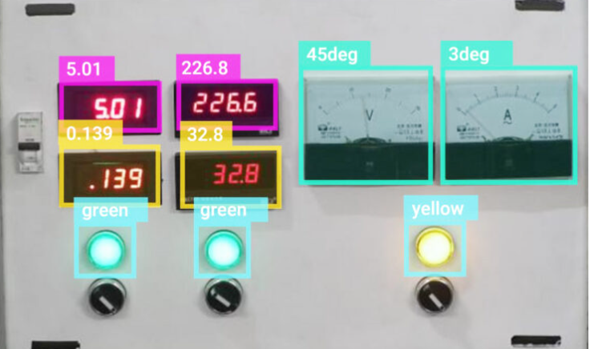
Predictive maintenance
Remote monitoring and automated event notifications by reading analogue gauges with computer vision

Slide 31
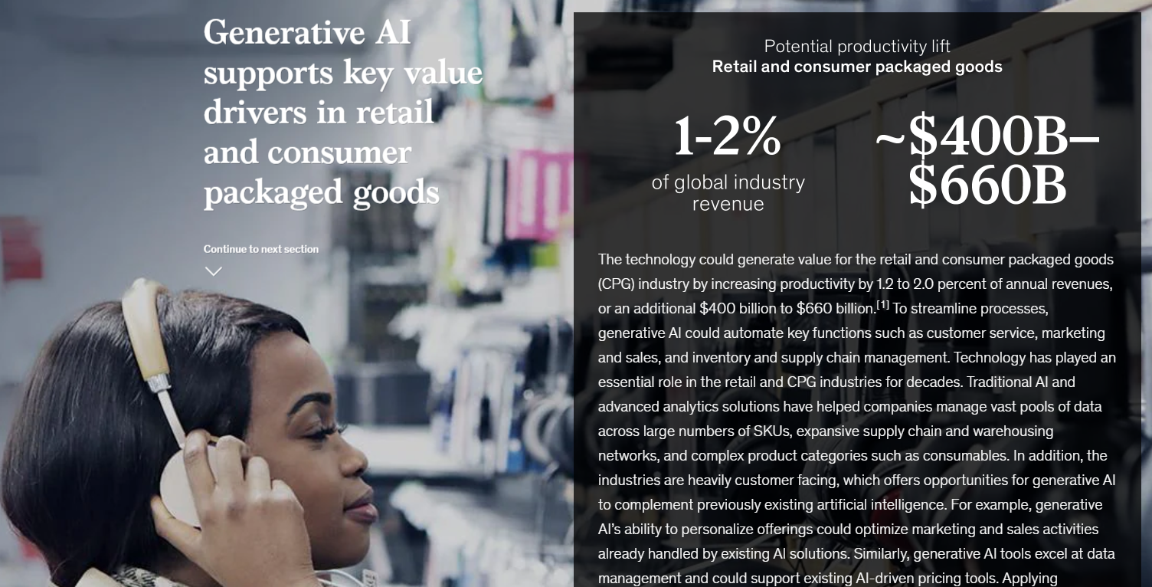
Retail

Slide 32
Retail example: Stitchfix
Stitch Fix, which uses algorithms to suggest style choices to its customers, has experimented with DALL·E to visualize products based on customer preferences regarding color, fabric, and style.
Using text-to-image generation, the company’s stylists can visualize an article of clothing based on a consumer’s preferences and then identify a similar article among Stitch Fix’s inventory.

Slide 33
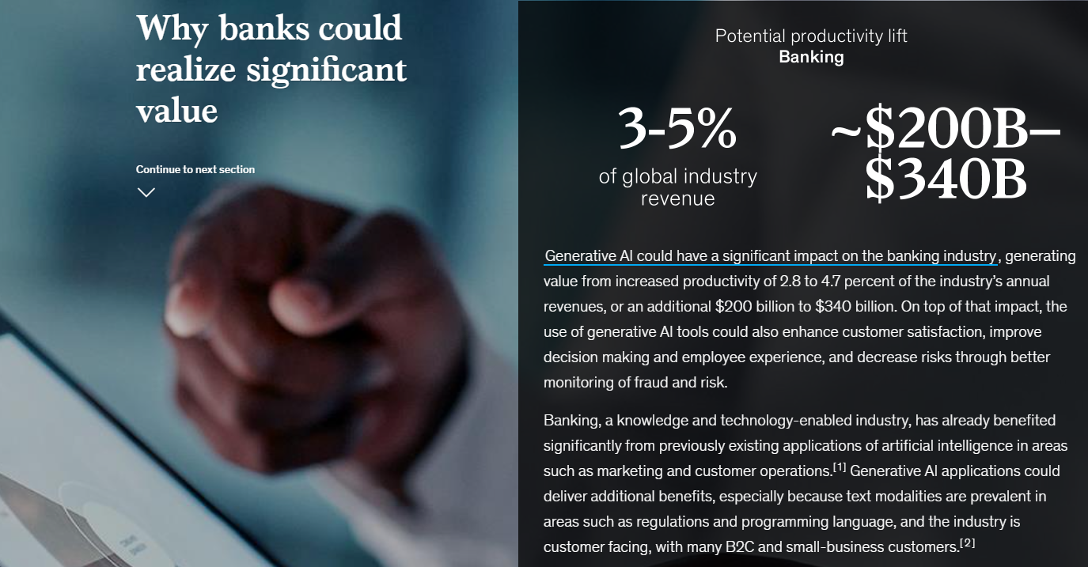
Banking

Slide 34
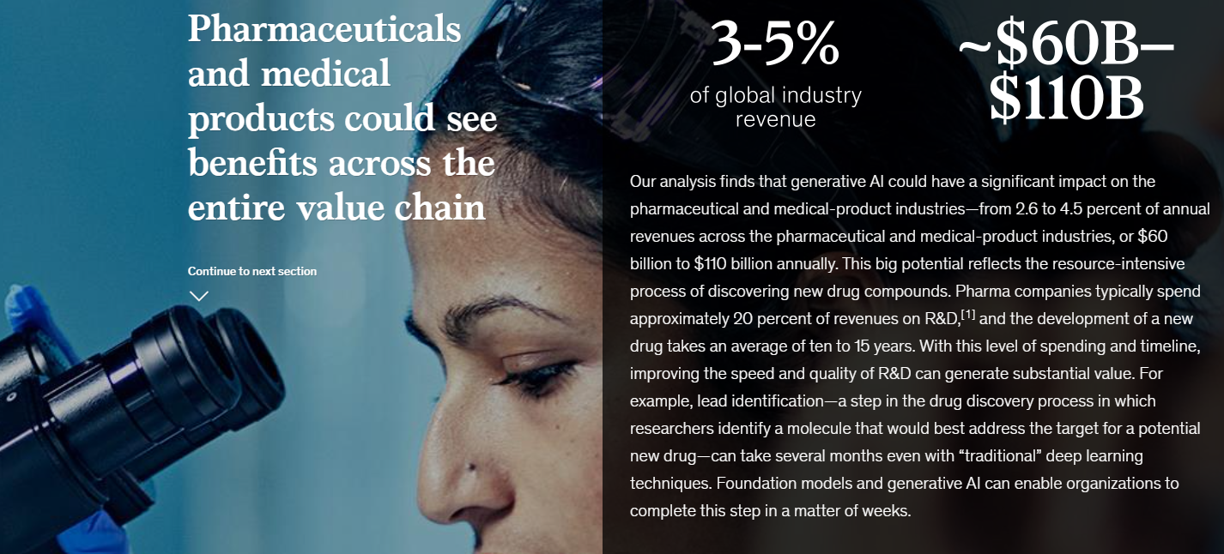
Pharmaceuticals

Slide 35

Media and Entertainment
https://www.youtube.com/watch?v=q2ITXhM-53I

